Slide 1
Church-Service Missionary Program Vision Statement
Help souls come closer to Christ while supporting the continued growth and progress of the Church.

Slide 2
Church-service Missionary Program Mission Statement
Facilitate the matching of Church-service missionaries and volunteers to the resource needs of Church departments and operations, thus blessing the lives of those who serve and those who are served.

Slide 3
Church-service Missionary Program Core Values

Slide 4
Church-service Missionary Program Core Values
Align with the Brethren: All program components are aligned with the desires and direction of the Brethren.
Create Great Mission Experiences: Missionaries, priesthood leaders, and operations managers have positive experiences with the CSM program.
Meet Service Needs: Operations’ needs for missionaries and volunteers to provide goods and services are known, tracked, and fulfilled.
Increase Awareness: Priesthood leaders, members, and operations managers understand the CSM program and how it can bless them and the Church.
Provide Tools and Resources: The needed policies, processes, information, and tools are provided to ensure success.

Slide 5
Church-service Missionary Program Key Operational Performance Indicators/Goals
100 percent of assigned operations adequately* staffed
100 percent of current assigned positions filled
Timely processing of online recommendations
Timely approval of requested extensions and early releases
* Adequately staffed means all positons assigned to stakes to fill are filled on time.

Slide 6
Church-service Missionary Program Strategic Emphasis for 2015
Process and System Initiatives: Simplify and finalize ongoing improvements to existing core processes (fulfillment, coordination, YCSM) and support tools.
Marketing: Inspire and educate ecclesiastical leaders, operations and members to engage in the CSM program to bless lives.
Relationships: Foster and inspire Christ-like interactions between operations, missionaries, and ecclesiastical leaders
Communication: Foster free flowing communication among key participants to achieve the vision, mission and core values of the program
YCSM Program Enhancement: Complete domestic YCSM program pilots, rollouts

Slide 7
Church-service Missionary Program Key Participants and Relationships
Local Priesthood Leaders
CSMs/LTVs
and Members
Operation
Managers
CSM Coordinators
Notes:
The CSM program is like the “glue” that can help and assist these three groups of people. We are not in the direct line of authority either temporally or ecclesiastically, but strive to serve all of these groups.
The priesthood leaders whose units supply the missionaries, the operations who need them and the missionaries themselves need to be coordinating and communicating effectively.

Slide 8
The Leadership Pattern

Slide 9
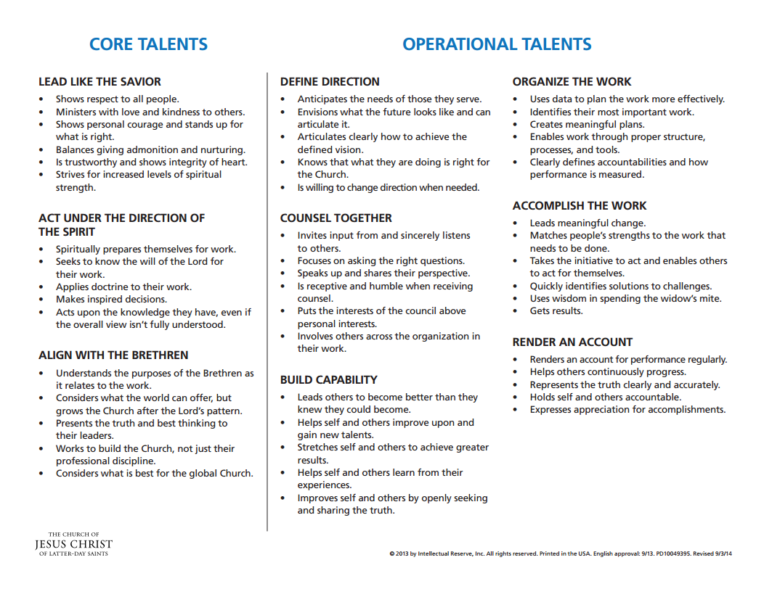
The Leadership Pattern

Slide 10
© 2015 by Intellectual Reserve, Inc. All rights reserved.

